Slide 1
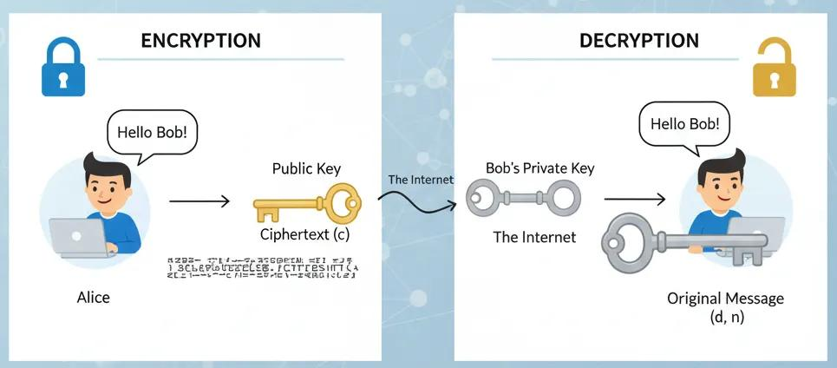
Week 2
Cryptanalysis of RSA (Rivest–Shamir–Adleman)
Definition
RSA is an asymmetric encryption algorithm that uses two different keys:
Public Key – Used to encrypt data (shared with everyone).
Private Key – Used to decrypt data (kept secret by the owner).

Slide 2
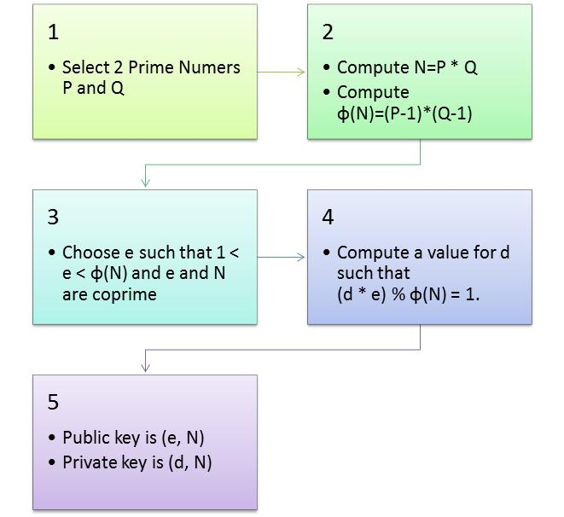
Procedure

Slide 3
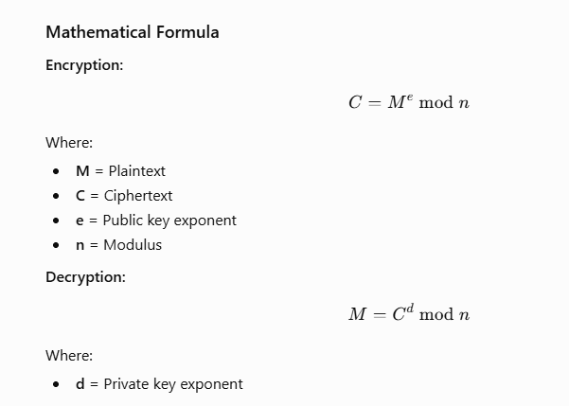

Slide 4
RSA Example (Using the Text "HELLO")
Step 1: Choose Prime Numbers
p=3
q=11
Step 2: Calculate n
n=p×q=3×11=33
Step 3: Calculate Euler's Totient
ϕ(n)=(p−1)(q−1)=(3−1)(11−1)=2×10=20
Step 4: Choose Public Key
Choose:
e=3 Since gcd(3, 20) = 1, it is valid.(Greatest Common Divisor)
Step 5: Calculate Private Key
Find d such that
(d×e)mod 20 ≡1
7*3=21
21 mod 20=1
Therefore,
d=7
Keys
Public Key: (e,n)=(3,33)
Private Key: (d,n)=(7,33)

Slide 5
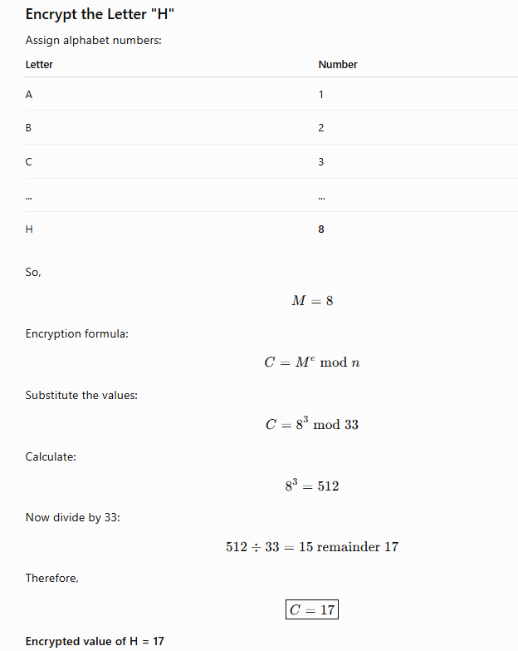

Slide 6
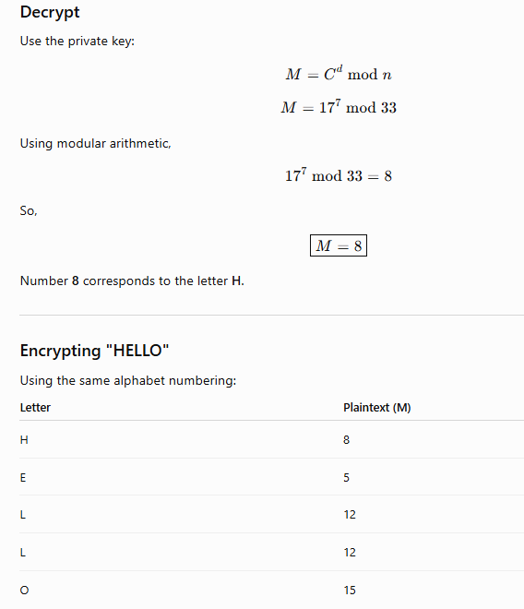

Slide 7
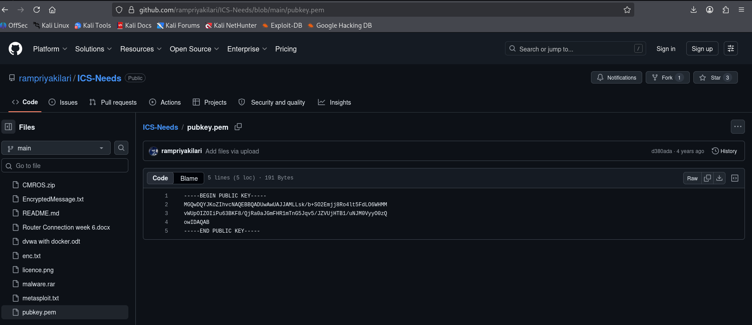
Download Files From github.com/rampriyakilari/ICS-Needs

Slide 8
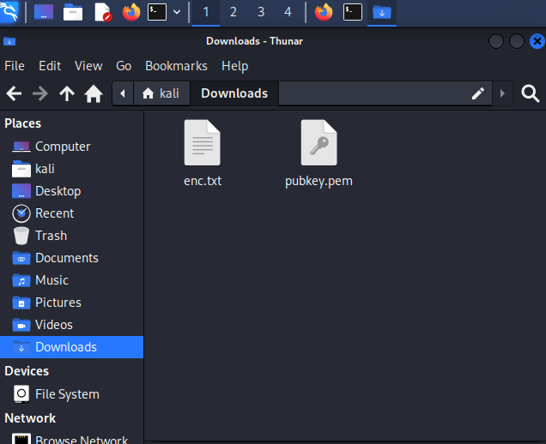
Downloaded enc.txt and pubkey.pem

Slide 9
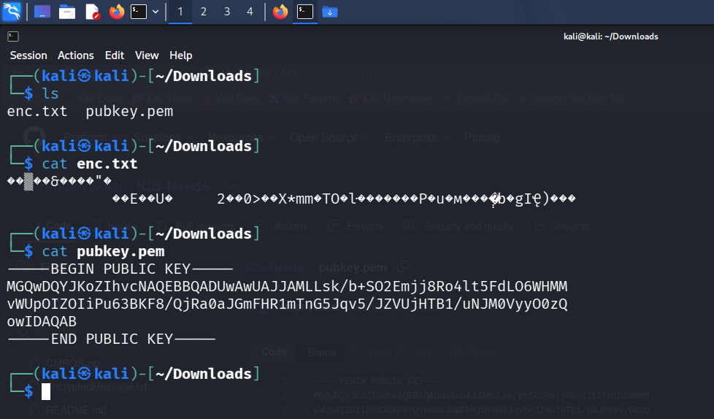
Check using cat command. Here pubkey.pem(privacy enhanced mail) convert hexadecimal to decimal

Slide 10
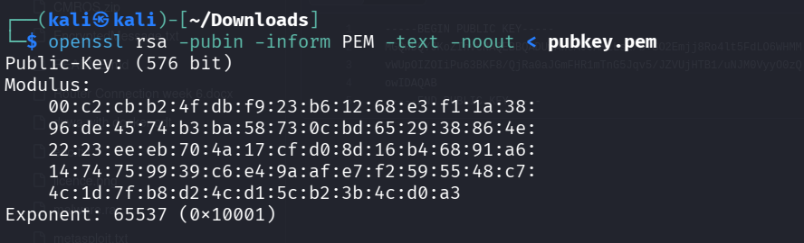
Here pubkey.pem(privacy enhanced mail) hexadecimal openssl rsa -pubin -inform PEM -text -noout < pubkey.pem

Slide 11
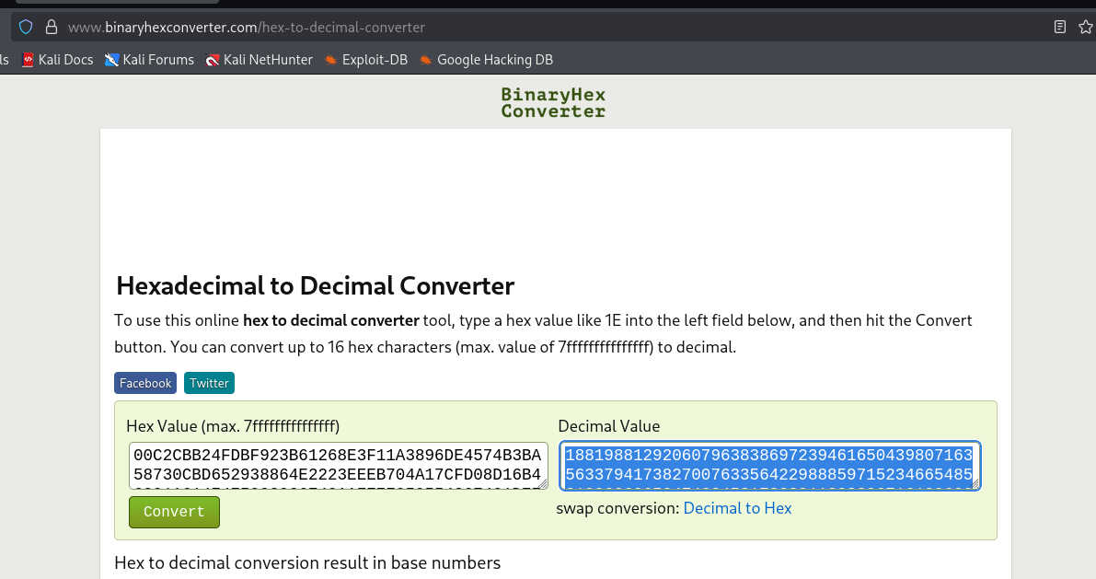
convert hexadecimal to decimal

Slide 12
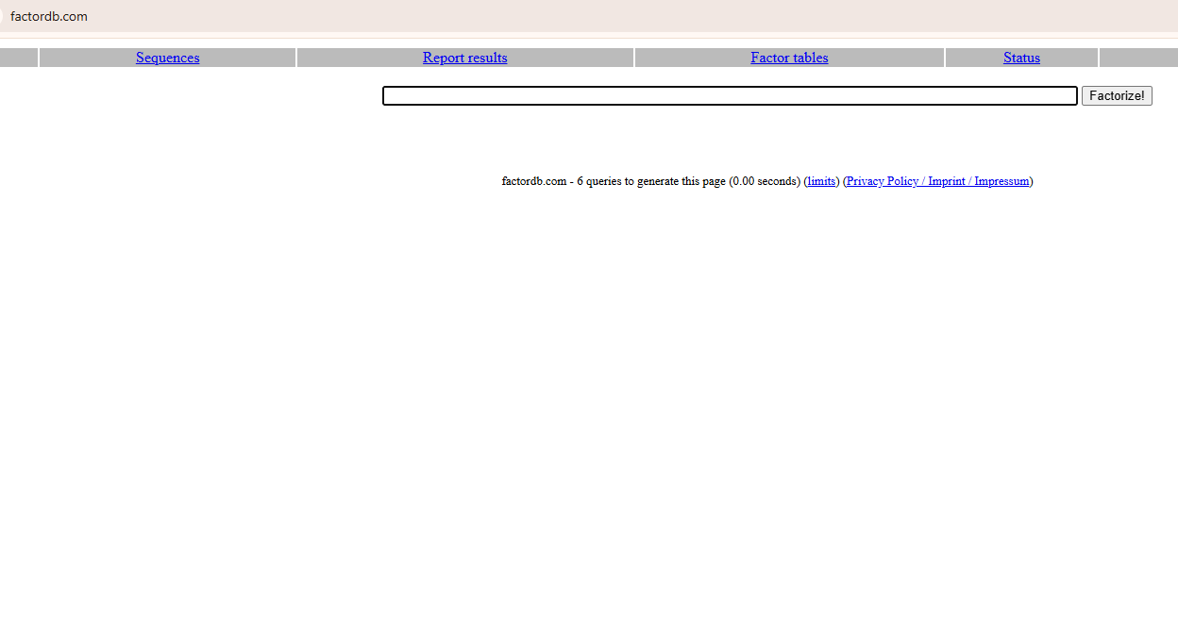
Use factordb.com to take p and q value

Slide 13
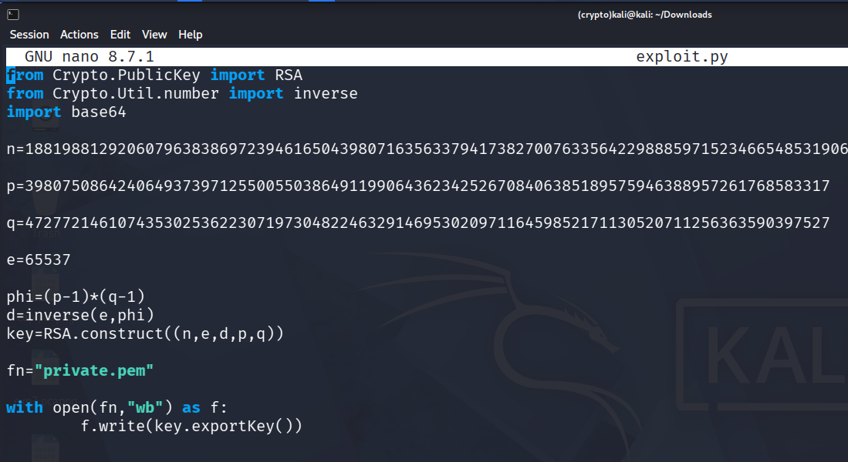
nano exploit.py (Ctrl+X,Y,Enter)Exit Purpose.

Slide 14
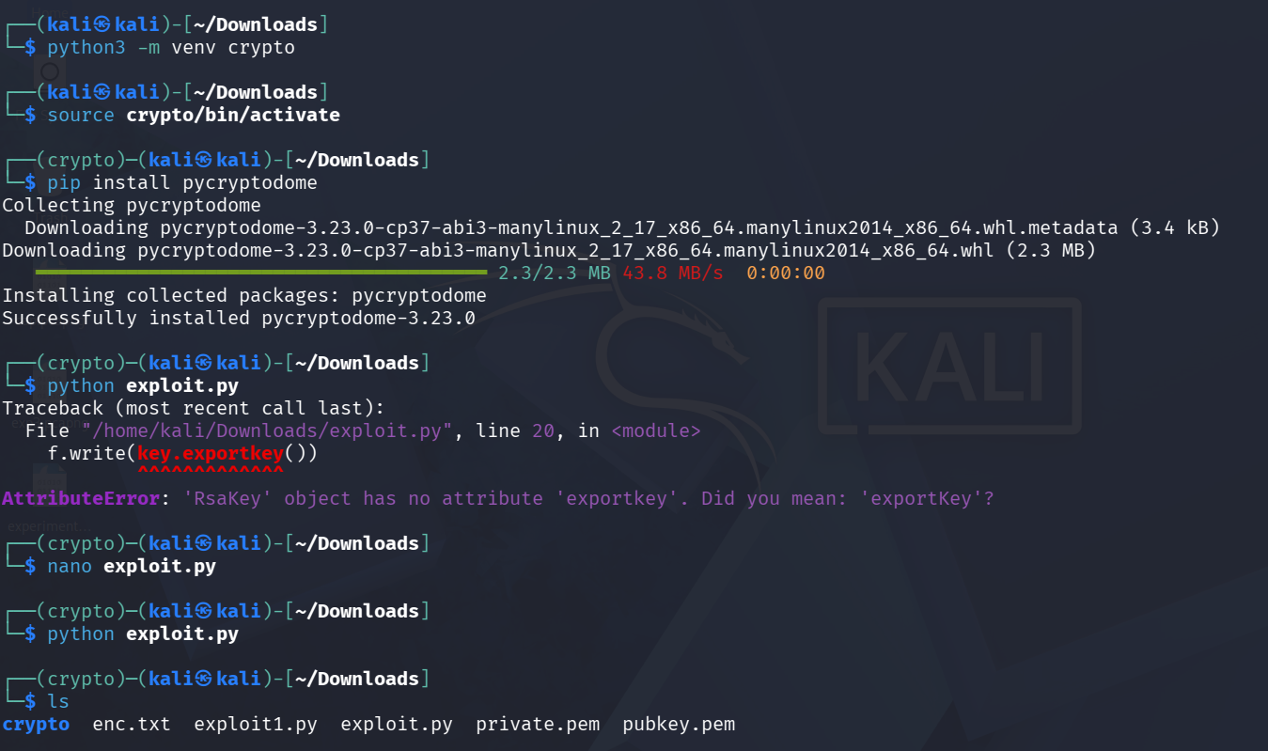
Exploit.py code using to Generated private.pem

Slide 15
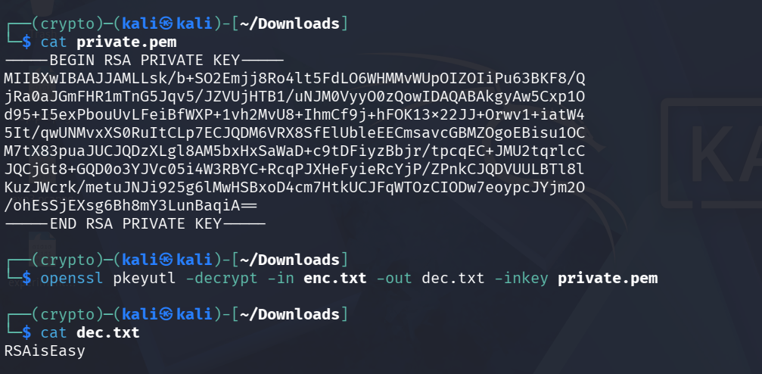
Use following Command to Decrypt openssl pkeyutl -decrypt -in enc.txt -out dec.txt -inkey private.pem

Slide 16
THANK YOU

